Slide 1
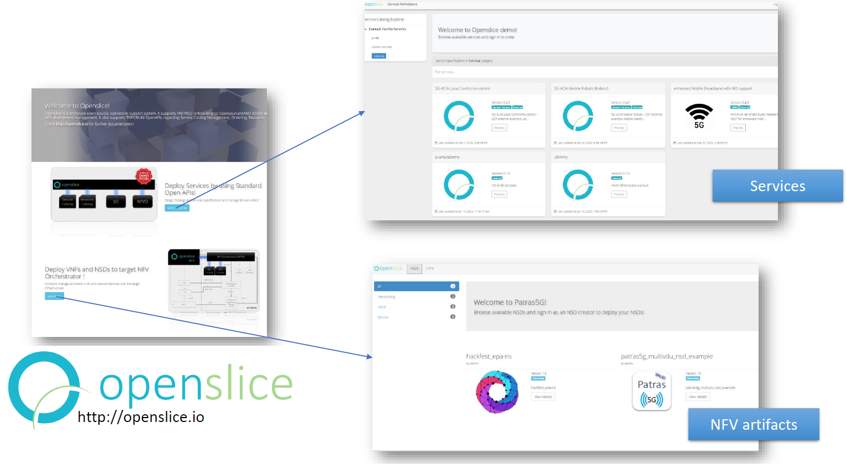
OpenSlice Main Interface

Slide 2
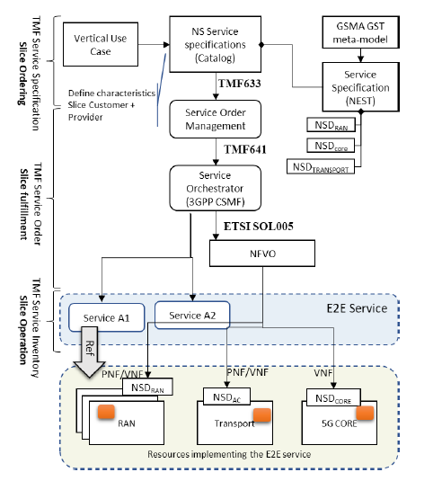
Network Slice Instantiation in Openslice

Slide 3
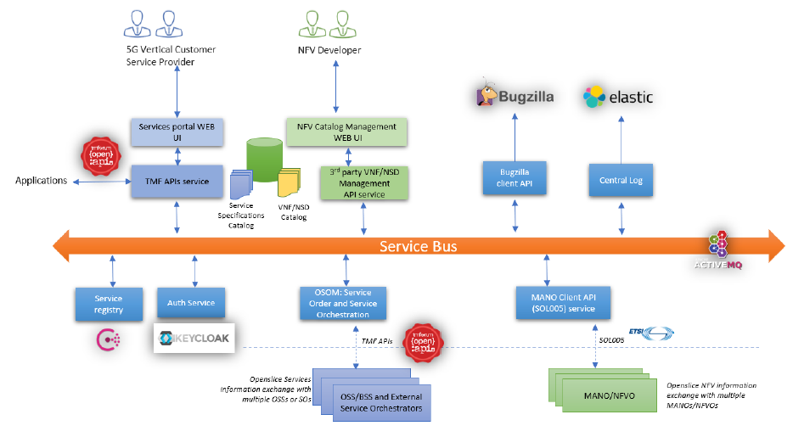
OpenSlice Architecture

Slide 4
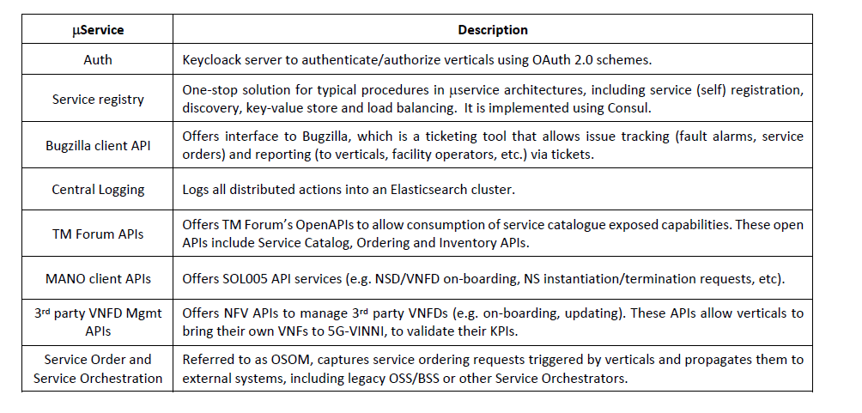
OpenSlice Microservices

Slide 5
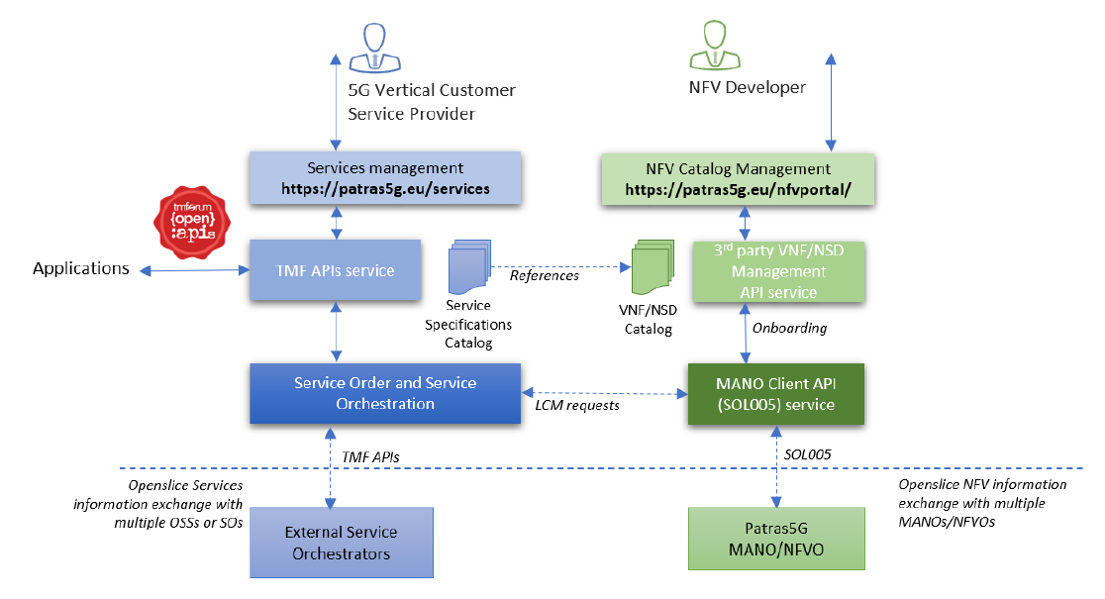
Openslice Protocol and Data Model

Slide 6
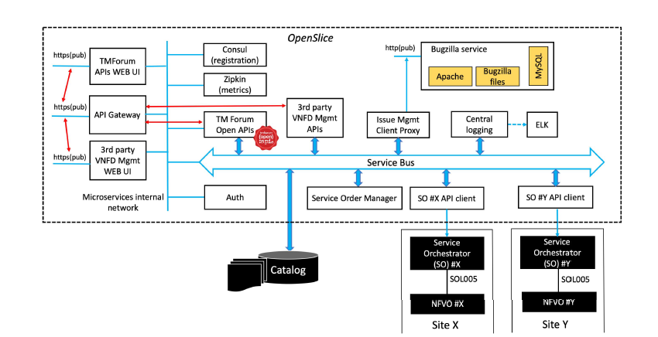
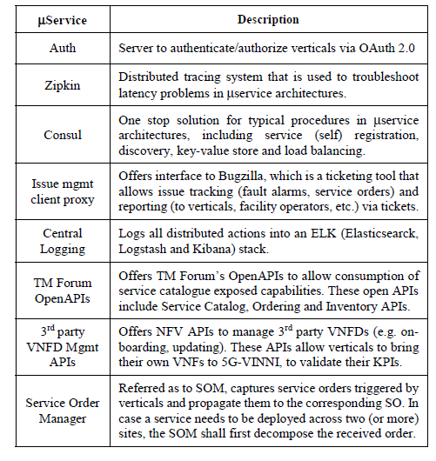
Openslice Framework

Slide 7
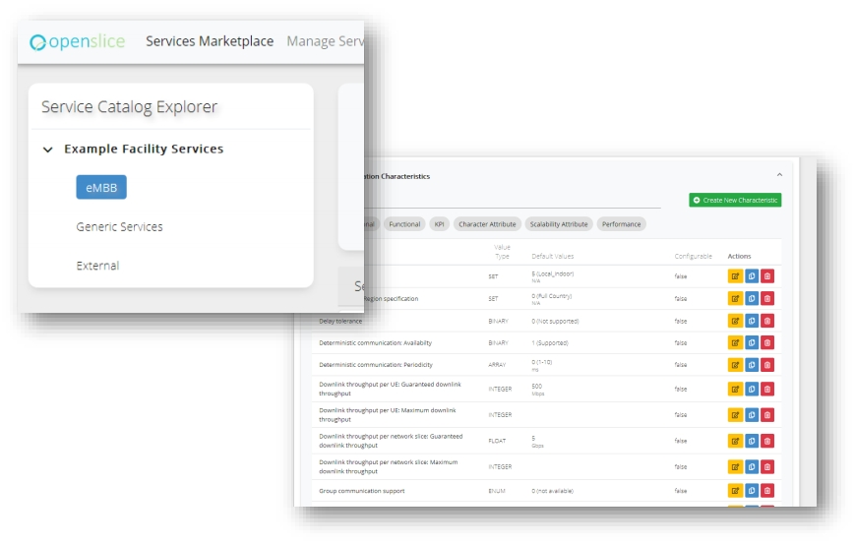
Service Catalog/Service Specification Design
TMF633 - Service Catalog Management
TMF634 - Resource Catalog Management (no UI currently)

Slide 8
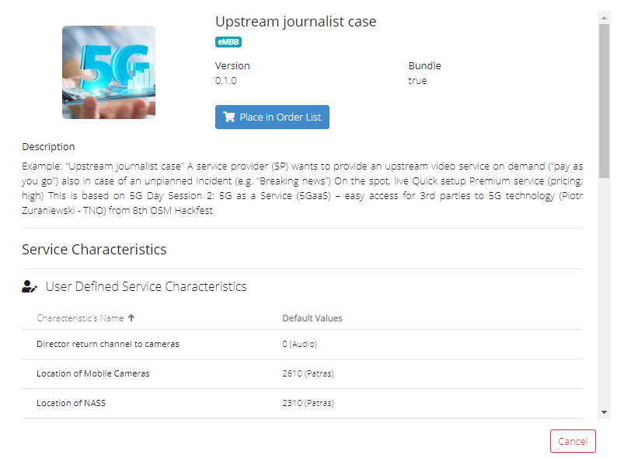
Openslice Service CFS example

Slide 9
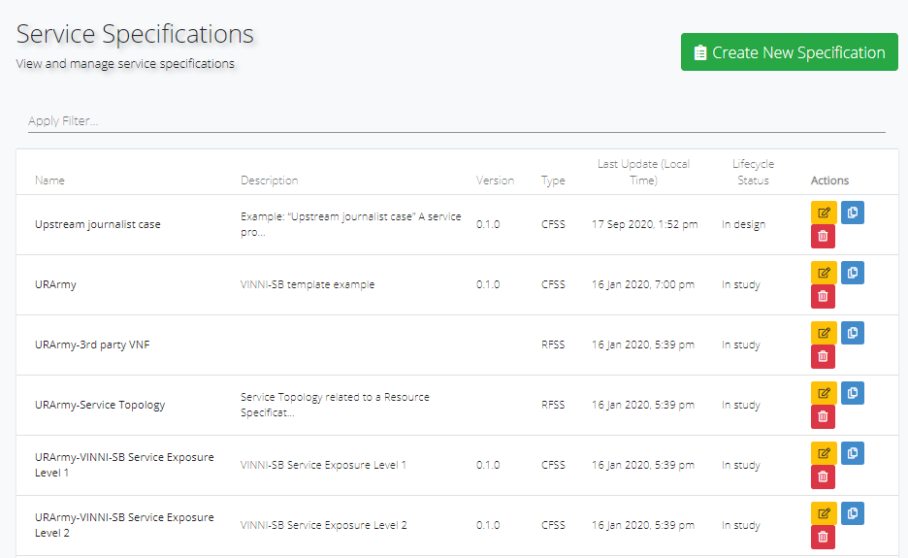
List of Service Specifications, both RFSs and CFs

Slide 10
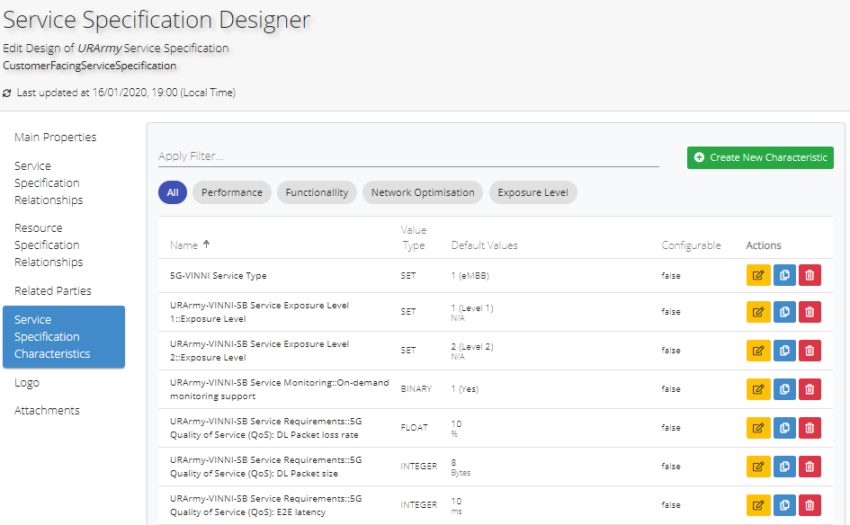
Openslice Service Specification design example

Slide 11
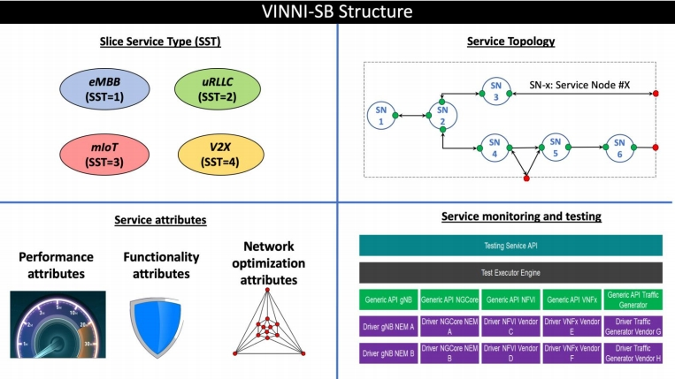
5G-VINNI Service Blueprint (VINNI-SB)
• Model-based service template
for service ordering in NSaaS.
• Extending GSMA’s Generic Slice
Template (GST), including
experimentation related attributes:
• Monitoring
• Testing

Slide 12
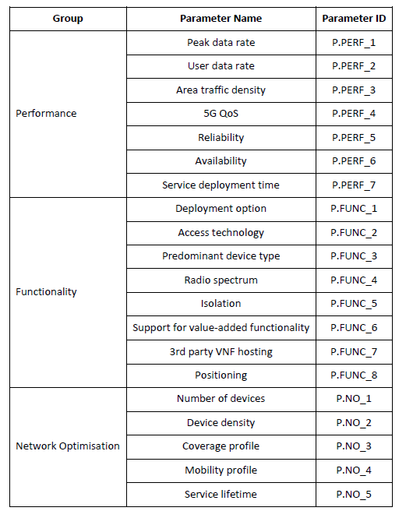
5G-VINNI-SB Attributes

Slide 13
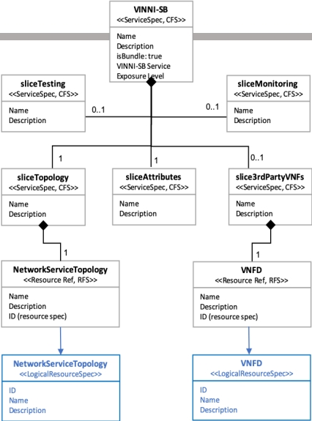
Model Diagram of VINNI-SB
Definition of a common information model for the entire 5G-VINNI facility:
Site-agnostic design of network slices.
Ensures reproducibility and facilitates cross-site slice deployments
Model following TM Forum’s information Framework (SID)

Slide 14
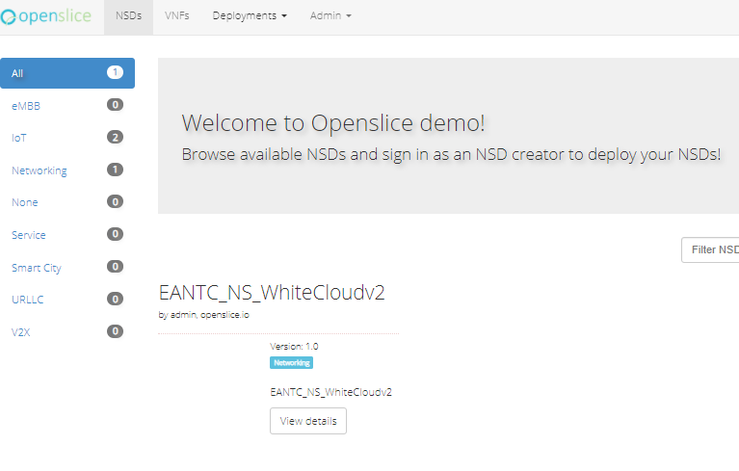
The NFV Catalog

Slide 15
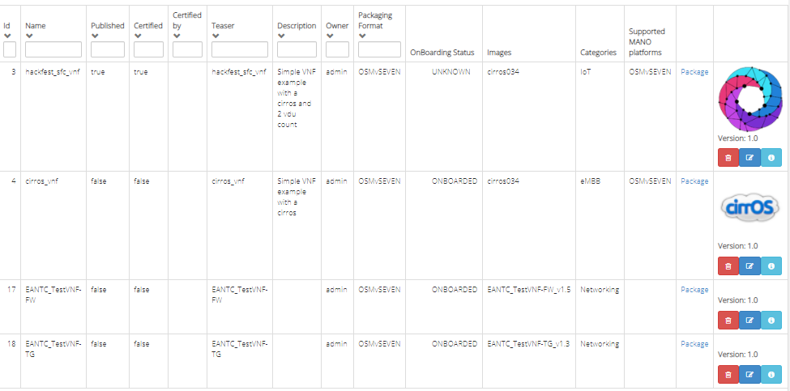
Available Onboarded VNFs

Slide 16
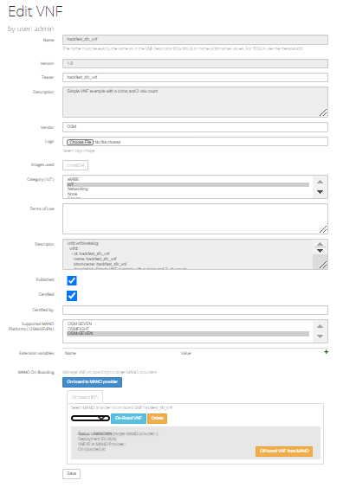
Edit an Onboarded VNF

Slide 17
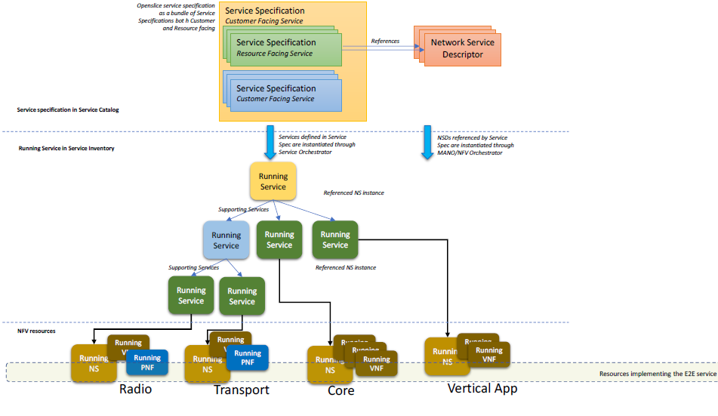
Service Specifications, Service Order and Running Services related with instantiated running Network Service

Slide 18
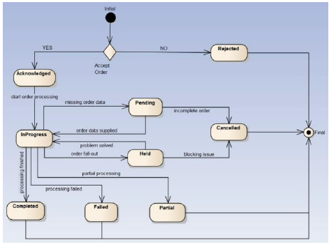
Service Order follows the states as defined in TMF641 specification

Slide 19
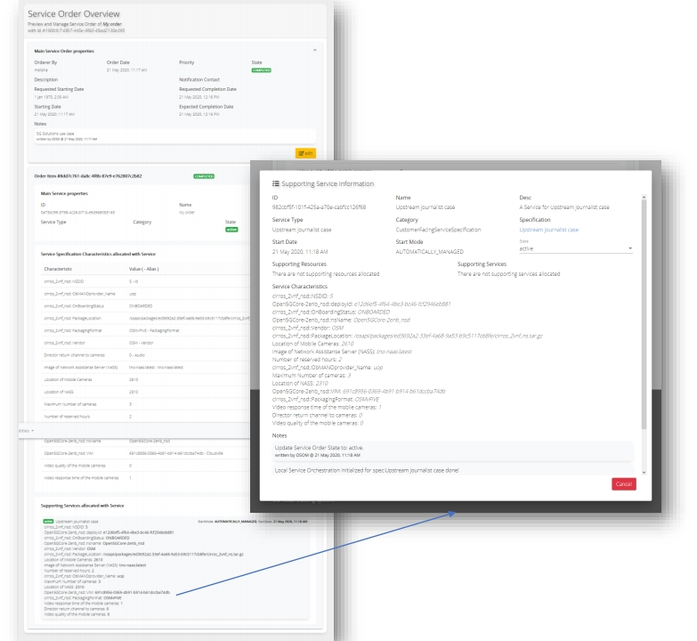
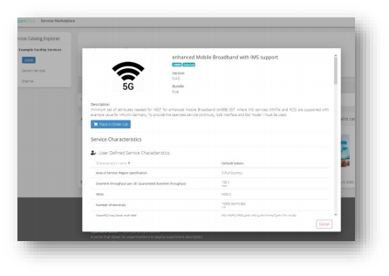
Service Order and SOM
TMF 638 - Service Inventory Management
TMF 640 - Service Activation and Configuration
TMF 641 - Service Ordering Management

Slide 20
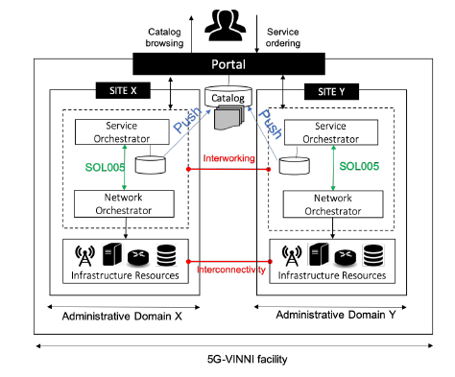
Open Slice Portal in a multi-vendor facility

Slide 21
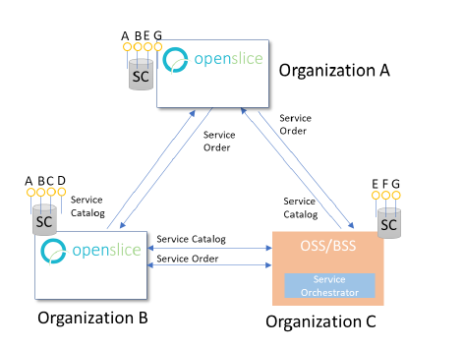
Openslice in a mesh connectivity for service exchange between Providers

Slide 22
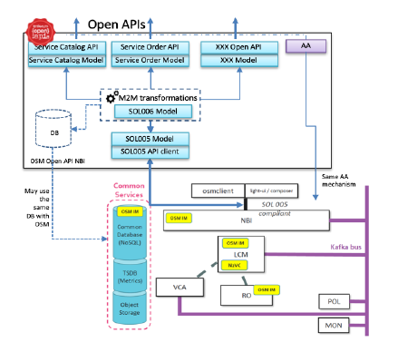
TM Forum Open APIs in Open Source MANO (OSM)

Slide 23
Supported TMF APIs in Openslice
TMF 620 - Product Catalog Management
TMF 622 - Product Ordering Management
TMF 633 - Service Catalog Management
TMF 634 - Resource Catalog Management
TMF 638 - Service Inventory Management
TMF 640 - Service Activation and Configuration
TMF 641 - Service Ordering Management
TMF 666 - Account Management specification
TMF 669 - Party Role Management
TMF 629 - Customer Management
TMF 632 - Party management

Slide 24
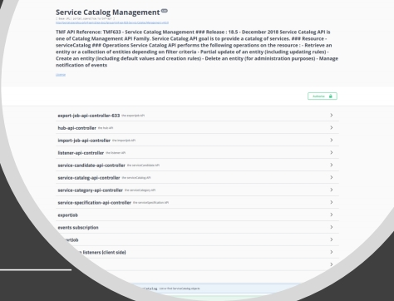
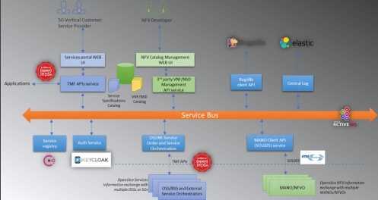
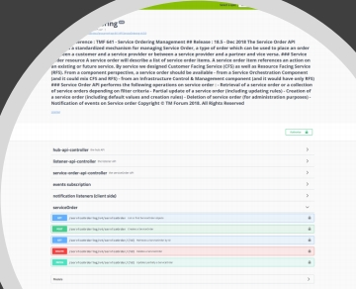
Openslice Open API access
•
•
•
•
Supported TMF OpenAPIs for programmatic access by Vertical Applications
For a quick access check our swagger links:
TMF APIs: http://portal.openslice.io/tmf-api/swagger-ui.html
API for VNF/NSD management: http://portal.openslice.io/osapi/swagger-ui.html

Slide 25
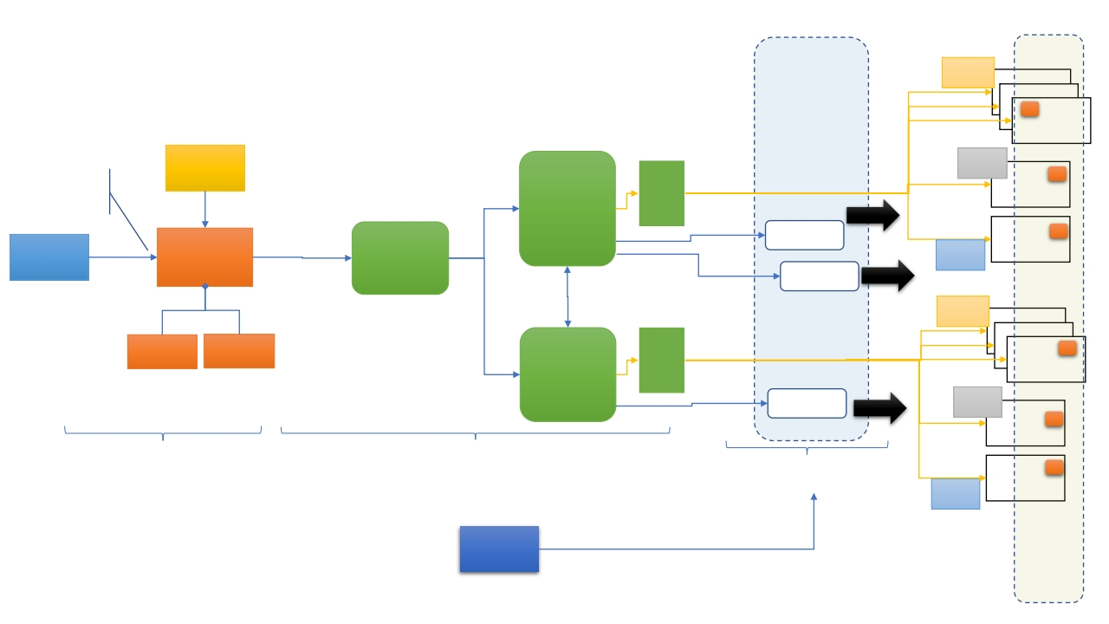
From Service Order to E2E Service and Resources
E2E Service
NSD AA
RAN
RAN
RAN
PNF/VNF
GST/VINNI-
SB met-
model
NSD AB
VNF
PNF/VNF
Define characteristics
Slice Customer +
Provider
5G CORE
TMF641
Service
Orchestrator
Facility A
NFVO
Ref
Vertical
Use Case
VINNI-SB
specification
(Catalog)
Service A1
Service A2
Transport
order
TMF633
Service Order
Management
NSD AC
Ref
5G-VINNI Portal
bundle
TMF638/TMF640
NSD BA
RAN
Service Spec
Facility A
Service Spec
Facility B
Service
Orchestrator
Facility B
RAN
RAN
TMF641
NFVO
PNF/VNF
Service B1
Ref
VNF
NSD BB
5G CORE
TMF Service Specification
Slice Ordering
TMF Service Order
Slice fulfillment
TMF Service Inventory
Slice Operation
Transport
NSD BC
Vertical
Modify the running Service through
Service Inventory API
Resources
implemen
ting the
E2E
service

Slide 26
High level from service order to E2E Service
Specification and Service Catalog follow the model of (TMF633)
The service specifications comprise of exposed to SC CFS and internal RFS.
The derived NEST (RFS) is modeled also as TMF Service Specification
A NEST may be a Service Bundle (consists of several other RFSs). each RFS related with underlying NSDs(VNFs).
Service Orders are modeled with the Service Ordering API (TMF641)
In a service order, is provided a completed specification of the slice via the Service Ordering API
The issued service order is propagated to the SO via (TMF641)
Service order is translated to the corresponding CFS RFS resource requirements
The NFVO allocates the slice instance instructing the VIM
Upon slice is instatiated the vertical keeps track of the status of the slice instance, via the Service Inventory API (TMF638)

Slide 27
The Onboarding and Testing Process

Slide 28
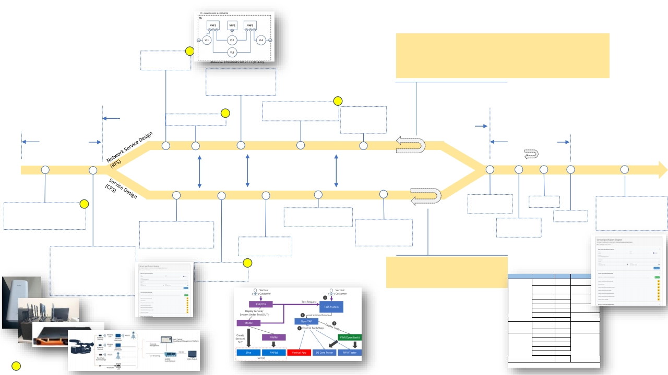
-
-
-
-
-
This cycle might be repeated multiple times
NFV orchestration is key part to repeatability of NF deployments/testing
Self service onboarding/off boarding, deployment test and access - Access Level 1
facility might offer to vertical a staging area (e.g. a private OSM to experiment) or NFVO
itself – Access Level 2 and 3
facility might offer to vertical VIM access – Access Level 4
Co-develop
period
VNFD/NSD
development
- VNF/NSD testing
-Understand/automate
measurement points
-Involve Monitoring aaS
-Involve Testing aaS
VNFD/NSD onboarding
Pre-validation
KPI period
Via NFVO
Vertical and facility
co-design period
Operational &Testing
KPI period
Study service specs to
network requirements
Study service specs to
MaaS & TaaS
requirements
Iteratively develop Service and NFV
orchestrators “choreography”
Service Spec is
Launched
E2E Service
Order Fulfilled
Testing
Offer the Service Blueprint
to the Vertical community
For repeatable
deployments
Install parts of the use case
If possible, Execute even non
automated with manual parts
Launch Service Spec
Alpha/beta versions
Assessment
Design the Service Blueprint
NSaaS Spec with its
characteristics
Pre-Validation KPI
period via Service
Orchestrator
Test deployment/
Understand:
activation of SB
- Network requirements
- Measurement points
- What can (must) be automated
-This cycle might be repeated multiple times
- Service and NFV orchestration is key part to
repeatability of NF deployments/testing
Test case design
Test scripts for TaaS
- What can be parameterized
Prepare onboarding Plan
Category
KPIs
Achieved Values
Description
UL Maximum Throughput
(Mbit/s)
DL Maximum Throughput
(Mbit/s)
UL Latency (ms)
104.27 Mbit/s
883.69 Mbit/s
13.77 ms
mmWave, 27.3-27.5 GHz, 4T4R, 1
stream
mmWave, 27.3-27.5 GHz, 4T4R,
40 streams.
3.6GHz, low foot-print traffic
E2E Network Performance
NFVI Network Performance
NFVI Compute Resource
Performance
DL Latency (ms)
UL Jitter (ms)
DL Jitter (ms)
UL Frame Loss (%)
DL Frame Loss (%)
Maximum Throughput (0
Frame Loss)
Latency between VMs
CPU Benchmarking Score
Memory Read Latency
Memory r/w Bandwidth
Storage r/w IOPS
Storage r/w Latency
Storage r/w Bandwidth
9.15 ms
1.01 ms
0 ms
0.01%
0%
4.573 Gbit/s
0.067 ms
3,510
7.97 ns
25.641 GB/s
5.65 k / 4.21 k
188 / 621 ms
1,018 / 425
MB/s
profile with 100Kbit/s bandwidth.
mmWave, 27.3-27.5 GHz, 4T4R,
low foot-print traffic profile with
100Kbit/s bandwidth.
3.6GHz, low foot-print traffic
profile with 100Kbit/s bandwidth.
two compute nodes, DPDK was
configured in the test
environment.
Yardstick CPU/Memory/Storage
tests.
Optional

Slide 29
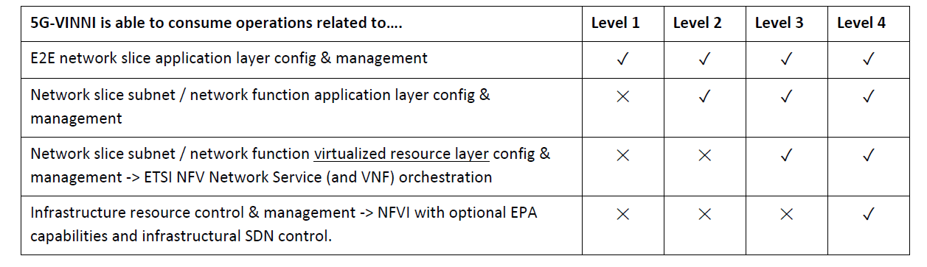
The different exposure levels highlighting that higher the exposure level, the more advanced capabilities the vertical can get.

Slide 30
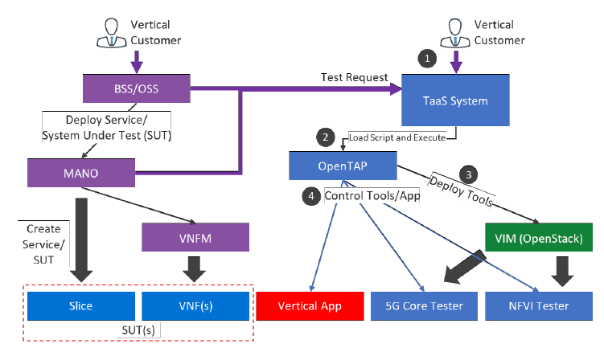
Consuming a TaaS Service

Slide 31
Initial KPIs validation results
Category | KPIs | AchievedValues | Description
E2ENetworkPerformance | ULMaximumThroughput(Mbit/s) | 104.27Mbit/s | mmWave,27.3-27.5GHz,4T4R,1stream
 | DLMaximumThroughput(Mbit/s) | 883.69Mbit/s | mmWave,27.3-27.5GHz,4T4R,40streams.
 | ULLatency(ms) | 13.77ms | 3.6GHz,lowfoot-printtrafficprofilewith 100Kbit/sbandwidth.
 | DLLatency(ms) | 9.15ms
 | ULJitter(ms) | 1.01ms | mmWave,27.3-27.5GHz,4T4R,lowfoot-print trafficprofilewith100Kbit/sbandwidth.
 | DLJitter(ms) | 0ms
 | ULFrameLoss(%) | 0.01% | 3.6GHz,lowfoot-printtrafficprofilewith 100Kbit/sbandwidth.
 | DLFrameLoss(%) | 0%
NFVINetworkPerformance | MaximumThroughput(0FrameLoss) | 4.573Gbit/s | twocomputenodes,DPDKwasconfiguredin thetestenvironment.
 | LatencybetweenVMs | 0.067ms
NFVIComputeResource Performance | CPUBenchmarkingScore | 3,510 | YardstickCPU/Memory/Storagetests.
 | MemoryReadLatency | 7.97ns
 | Memoryr/wBandwidth | 25.641GB/s
 | Storager/wIOPS | 5.65k/4.21k
 | Storager/wLatency | 188/621ms
 | Storager/wBandwidth | 1,018/425MB/s

Slide 32
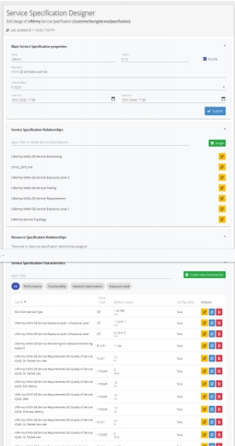

http://openslice.io
Openslice is a prototype open source, operations support system. It supports VNF/NSD onboarding to
OpenSourceMANO (OSM) and NSD deployment management. It also supports TMFORUM OpenAPIs
regarding Service Catalog Management, Ordering, Resource, etc.
Demo
• Openslice demo: http://portal.openslice.io/
• Openslice Service Catalogues and ordering:
http://portal.openslice.io/services/
Video demo
• https://youtu.be/KU8JPDFFl9A
Supported APIs
For a quick access check our swagger links:
• TMF APIs: http://portal.openslice.io/tmf-api/swagger-ui.html
• API for VNF/NSD management:
http://portal.openslice.io/osapi/swagger-ui.html

Slide 33
Questions?

